Slide 1
CSE2002 Principles of Compiler Design
MODULE - 6
Dr. WI. Sureshkumar
Associate Professor
School of Computer Science and Engineering (SCOPE)
VIT Vellore
wi.sureshkumar@vit.ac.in
SJT413A34

Slide 2
Symbol Table
When identifiers are found, they will be entered into a symbol table, which will hold all relevant information about identifiers.
This information will be used later by the semantic analyzer and the code generator.
Lexical
Analyzer
Syntax
Analyzer
Semantic
Analyzer
Code
Generator
Symbol
Table

Slide 3
Symbol Table Entries
We will store the following information about identifiers.
The name (as a string).
The data type.
The block level.
Its scope (global, local, or parameter).
Its offset from the base pointer (for local variables and parameters only).

Slide 4
Symbol Table Entries
This information is stored in an object called an IdEntry.
This information may not all be known at once.
We may begin by knowing only the name and data type, and then later learn the block level, scope, and the offset.

Slide 5
Symbol Table Functions
The two most basic symbol-table functions are the ones that insert a new symbol and lookup an old symbol.
IdEntry install(String s, int blkLev)
IdEntry idLookup(String s, int blkLev)

Slide 6
Inserting a Symbol
The install() function will insert a new symbol into the symbol table.
Each symbol has a block level.
Block level 1 = Keywords.
Block level 2 = Global variables.
Block level 3 = Parameters and local variables.
install() will create an IdEntry object and store it in the table.

Slide 7
Inserting a Symbol
When the symbol is first encountered by the lexer, we do not yet know the scope or type.
That is determined later by the parser.
For example, we could first encounter the symbol count in any of the following contexts.
int count; // Global variable
int func(int sum, float count);
int main() {int count…}

Slide 8
Looking up a Symbol
Whenever a symbol is encountered, we must look it up in the symbol table.
If it is the first encounter, then idLookup() will return null.
If it is not the first encounter, then idLookup() will return a reference to the IdEntry for that identifier found in the table.
Once we have the IdEntry object, we may add information to it.

Slide 9
Looking up a Symbol
Since a variable should be declared when it first appears,
If the parser is parsing a declaration, then it expects idLookup() to return null.
If the parser is not parsing a declaration, then it expects idLookup() to return non-null.
In each case, anything else is an error.

Slide 10
Block Levels
Keywords, global variables, and local variables are stored at different block levels.
C and C++ recognize further levels (blocks) within functions, delimited by braces { }.
However, in C, variables local to a block must be declared at the beginning of the block.
Every time we enter a block, the block level increases by 1 and every time we leave a block, it decreases by 1.

Slide 11
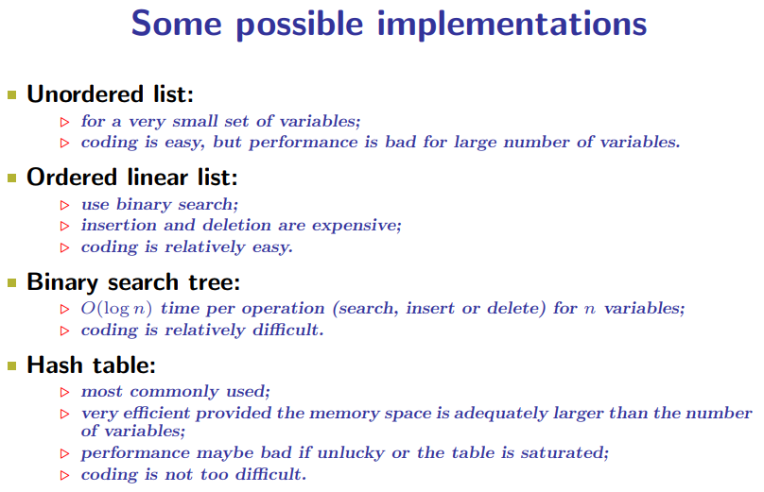

Slide 12
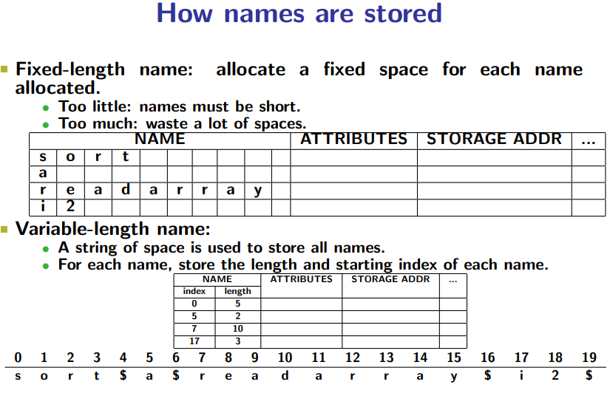

Slide 13
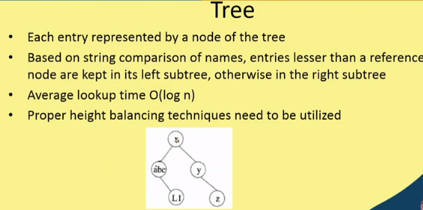

Slide 14
